Slide 1
Best Practice Crisis Response
Models

Slide 2



Use of paraprofessionals and technology
BEHAVIORAL HEALTH AIDES
  case management, routine care and med management
  assess and resolve crises, and refer
  training is key
Alaska
STATEWIDE TELEHEALTH “HUB”
  consult and support to BH aides and other paraprofessionals
  allows patients to be seen by professionals
  determination of when patients need transport
Notes:
Use of trained paraprofessionals to provide basic primary care and dental services in remote Alaskan villages is widespread, and this concept is now being used in behavioral health.
Dennis Mohatt, WICHE, “it is important to train local people to be able to assess and resolve crises and refer. But there has to be some ‘boots on the ground’ some capacity to respond. That is what these aides provide.
Mohatt says use of paras supported vy technology are many – including in the army with platoon level medics performing BH assessments and high end technology to connect people in the field with acute care settings

Slide 3


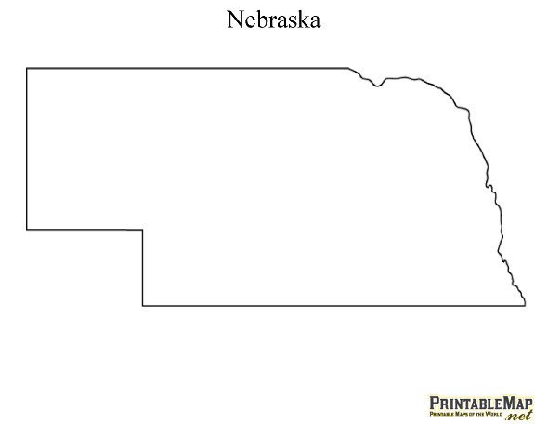

16 County Regional Crisis System
Diverted 84% of IPCP most recent fiscal year
MOBILE CRISIS RESPONSE COUNSELORS
  counselors respond to LEAs in person or virtually with secure iPad technology
  24/7 emergency community support case managers
  connect with clients during crisis event and for up to 90 days
SE NEBRASKA
LAW ENFORCEMENT
CIT TRAINING
REGIONAL
CRISIS STABILIZATION CENTER FOR INVOLUNTARY PROTECTIVE CUSTODY PLACEMENTS
SOBERING, DETOX AND TREATMENT CENTER
Notes:
2004, downsized state hospital beds, regional crisis services were supported
Regional crisis stabilization units for involuntary protective custody placements
Took advantage of the opportunity to build a system to respond to all types of crises
Keys to success: crisis counselors willing to travel and in some cases transport patients.
Warm handoffs to case managers officers are less likely to take a person into custody when they know there is a plan.

Slide 4

REGIONAL CRISIS CENTERS
Documented reductions in ED costs and usage in first year
23 hour, 59 minute stays
24/7 nursing staff assess before admission
Daytime bachelor’s level SWs
Psych techs 24/7
Clinical supervision provided weekly for MH and SUD
IDAHO

Slide 5



RURAL CRISIS STABILIZATION PROJECT
24/7 CRISIS ROOMS IN FIVE CRITICAL ACCESS HOSPITALS
IDAHO
STAFFED BY TEAMS FROM EXISTING LOCAL ORGANIZATIONS
  ED staff – medical stabilization
  Clinicians from Behavioral Health – assessment and evaluation, treatment, safety planning
  Safety observation – ED CNAs, psych techs
  Security and transport as needed – LEAs or designee
  Provide “just in time” services
TEAM TRAINING
Mental Health First Aid, Management of Aggressive Behavior, Crisis Assessment and Safety Planning
Notes:
Grangeville 3,123, Orofino 3,087, Cottonwood 910

Slide 6



SUGGESTIONS FOR RURAL AREAS
Use of telehealth for crisis response and psychiatry
24/7 BH support to LEA and hospitals – regular communication, meetings, joint protocols
Behavioral health training for law enforcement
A basic place to keep a person overnight
staffed with a paraprofessional or nurse, with a BH professional available for consult
Use of Sequential Intercept Mapping as a planning tool
MOUs among BH, LEAs, P&P, courts
E. OREGON

Slide 7
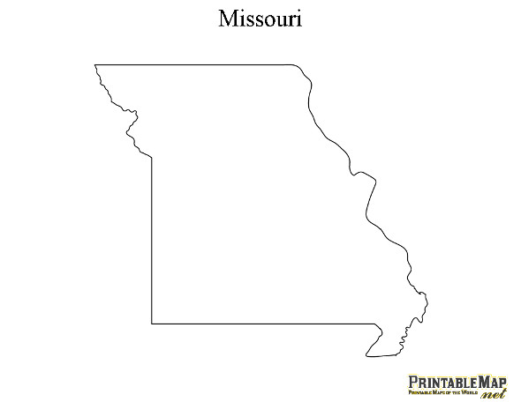
FOCUS ON LAW ENFORCEMENT,
COURTS AND HOSPITALS
BEHAVIORAL HEALTH PROFESSIONALS THAT ONLY TAKE LEA AND COURT REFERRALS
  mobile crisis services during business hours/next day service
  work with client for 30 days
  work in any setting necessary – homes, jails…
  assure people don’t fall through cracks
MISSOURI
BEHAVIORAL HEALTH PROFESSIONALS ASSIGNED TO EDs
LAW ENFORCEMENT TRAINING
  Including CIT adapted to rural areas
CLOSE
COLLABORATION
SKYPE IN SOME AREAS
Notes:
Community Behavioral Health Liaisons for police go to any location they are needed – people’s homes, jails, law enforcement staffing meetings.
Emergency Room Enhancement personnel are BH professionals that work solely in EDs
Make sure high utilizers don’t fall through the cracks.
Officer interviewed said Community Behavioral health liaisions are the best thing that ever happened to law enforcement

Slide 8
Key Components of high-functioning response system
Training for law enforcement
Intensive case management
Data sharing to enable warm hand-offs
Respite services for consumers and family members
Restoration/sobering place in lieu of jail - link to services
Higher levels of care when needed
Enrollment in Medicaid inside jails
NACBHDD

Slide 9
WORKFORCE SUGGESTIONS
Maximize use of mid-level providers supported by telehealth
Use paraprofessionals and EMTs with support
Train all responders in MHFA, some in CIT and assure training has a balance of info on MH, SUD and co-occurring
Train and educate place committed people
WICHE

Slide 10

Questions? Points for Action?
406-431-9260 | lovelandk@gmail.com

