Slide 1
What works across Intercepts
With information adapted from: The Sequential Intercept Model, Advancing Community-Based Solutions for Justice Involved Individuals with Mental and Substance Use Disorders, by Policy Research Associates, Delmar, NY

Slide 2
Across intercepts
Cross-systems collaboration and coordination of initiatives.
Routine identification of people with mental and substance use disorders.
Linkage to benefits to support treatment success
  including Medicaid and Social Security.
Information-sharing and performance measurement among behavioral health, criminal justice, and housing/ homelessness providers.
  identify high utilizers, provide an understanding of the population and its specific needs, and identify gaps in the system.

Slide 3
Universal Assessment
Warm hand offs/referrals
Treatment Planning
Behavioral Therapy
Monitoring
Case Management Pharmocotherapy
Recovery & Peer Support
Continuing care
Vocational services
Medical care
Education and childcare services
Legal services
Housing/ transport
Financial services

Slide 4
What works at each Intercept

Slide 5
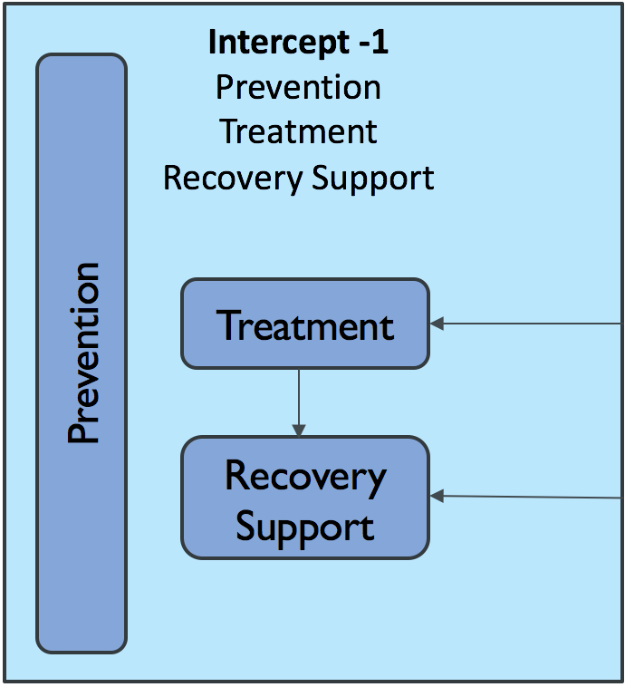
Intercept -1: Treatment and recovery
Universal screening/referral for MH and SUD in all possible settings
Integrated behavioral healthcare models
Comprehensive evidence-based treatment programs (i.e., MATRIX)
Use of MAT when appropriate
Continuum of care available to consumers as we have for chronic disease
Focused efforts to assist high needs consumers known to the system
Case management and connection to community-based services including housing, employment, benefits
Professional peer support
Recovery and social supports (AA, NA, MA, Phoenix)

Slide 6
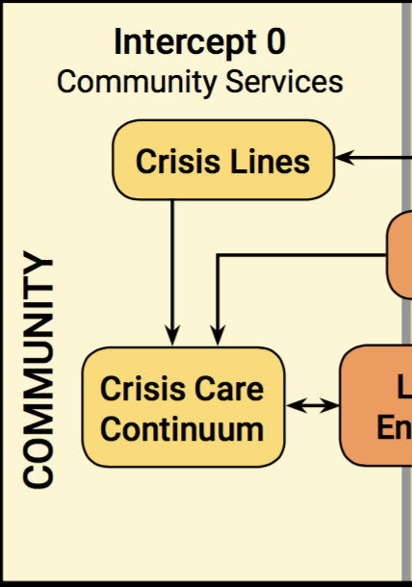
Intercept zero: Community Crisis Services
Maximize use of crisis lines and response teams (can be virtual) to divert and avoid transports
Clear, consistent communication between crisis line, 911, LEA
ED well connected to BH, with BH embedded if possible
ED diversion with embedded mobile crisis personnel or peer specialist
Connect with community services within 24-48 hours when leaving ED
EMS trained in BH
Peers involved in initial response, possibly in ED and after

Slide 7
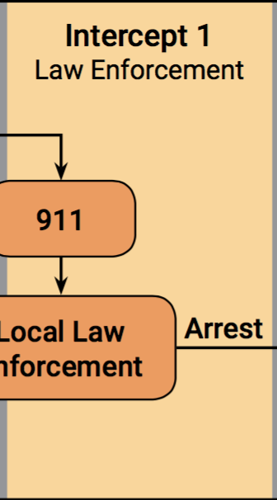
Intercept one: Law enforcement
LEAs trained in BH and well connected to BH providers
Co-Response Models
  BH and LEAs develop and refine response model, meet regularly
  Include a focus on reducing super-utilizers of 911 and ED
  Can involve peers
Specialized Policing Teams
  Crisis Intervention Teams (CIT)
  Co-responder teams
  Follow-up teams and supports
Dispatchers trained to recognize BH crisis and pass info along

Slide 8
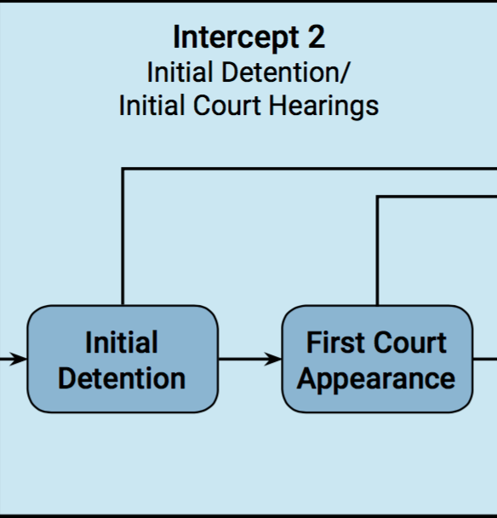
Intercept TWO: Initial detention & court hearings
Regular communication among LEA, BH, courts
Universal screening for MH and SUD and diversion to treatment when possible
  brief screens can be administered universally by non-clinical staff at jail booking, police holding cells, court lock ups, and prior to the first court appearance.
  divert Veterans to VA programs
Risk-based pre-trial services and pre-adjudication drug treatment courts
  to reduce incarceration of those at low risk for criminal activity
Courts more likely to divert if programs are in place

Slide 9
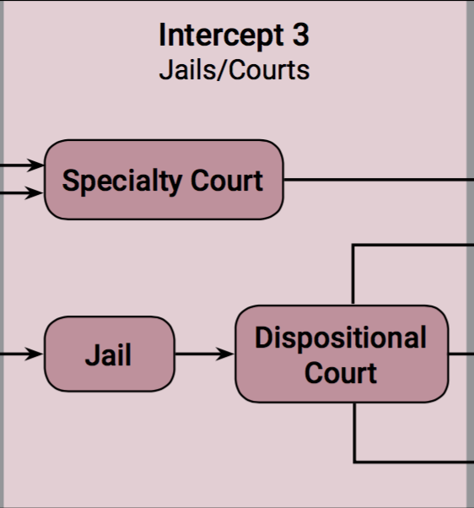
Intercept Three: Jails and Courts
Jails as HC settings need BH services and communication with BH providers
  National Commission on Correctional Healthcare can provide resources
Jails can use crisis line to connect prisoners to assessment and counseling
Connect inmates with benefits and meds before release
Specialized Courts: Drug Treatment, Community, Mental Health and Co-occurring Courts
Deferred prosecution for low level, low risk offenders

Slide 10
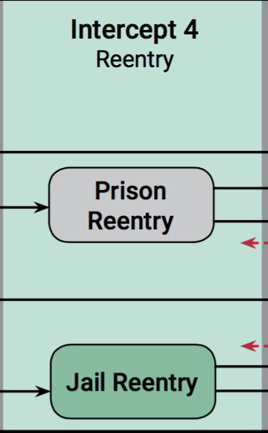
Intercept Four: Re-Entry
Transition planning by jail or in-reach providers:
  30 days of medications, Rx in hand
  community-based treatment
  recovery support
  community-based services, including housing, employement…
Warm handoffs from jail to providers
  case managers or peers that transport individuals directly to services
Assertive Community Treatment Teams (PACT)
Intensive Case Management Programs

Slide 11
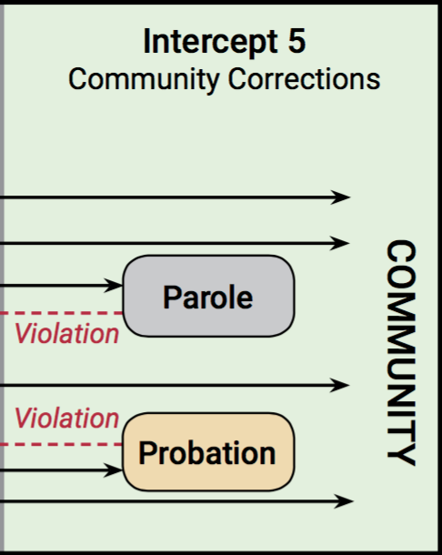
Intercept five: Community Corrections
Create specialized community supervision caseloads of people with behavioral health disorders.
Promote use of Medication-assisted treatment when appropriate to reduce relapse episodes and overdoses among individuals returning from detention.
As with Intercept 4, continue to increase access to recovery supports, benefits, housing, and employment.
Create a Forensic PACT team to reduce recidivism with stronger engagement in community services.

Slide 12

Questions? Points for Action?
406-431-9260 | lovelandk@gmail.com

